Slide 1
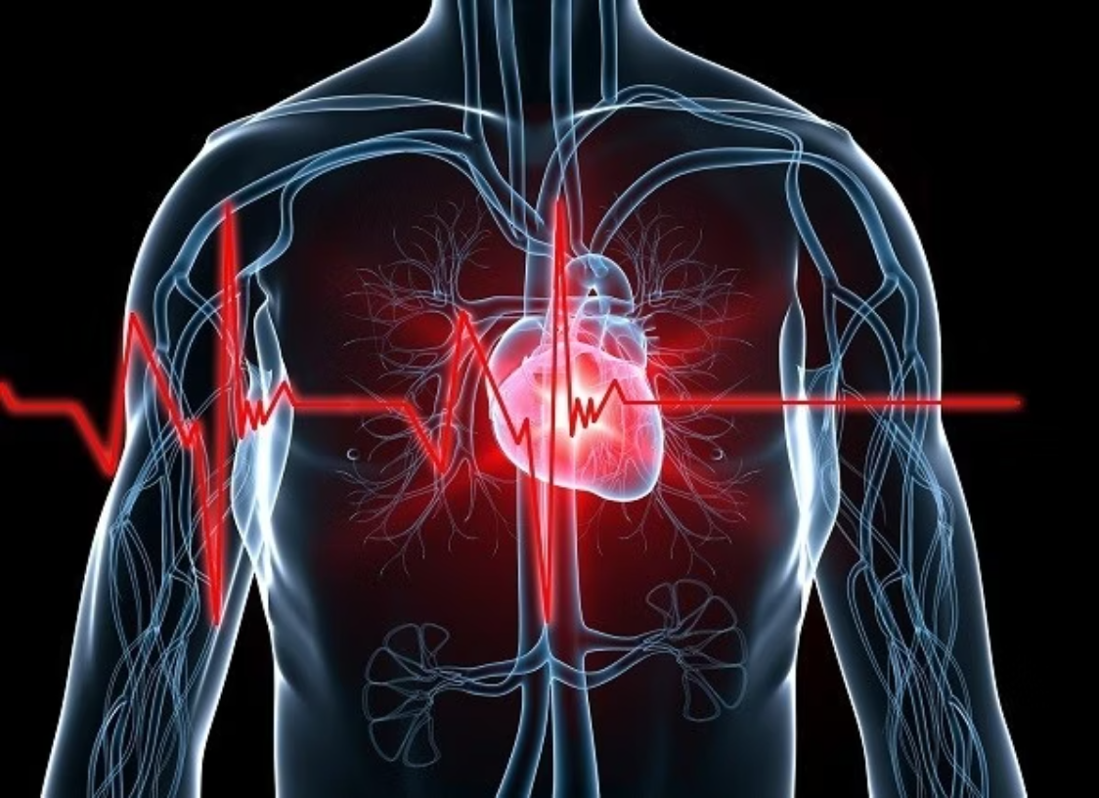
HEART DISEASE PREDICTION
USING LOGISTIC REGRESSION
Presented By: Auric Dutt
ID: 231003003152
Guide Name: Miss Naina Devi
Institute: Techno India University

Slide 2


CONTENTS
Problem Statement
Solution
Technologies Used
Data Pre-processing & Visualization
Model Building & Evaluation
Working of Web App
Applications
Problems Faced
Future Scopes

Slide 3

PROBLEM STATEMENT
Heart disease remains one of the leading causes of death worldwide. Early detection and timely diagnosis can significantly reduce the risk of severe complications and mortality.
However, manual diagnosis often depends on multiple clinical parameters, which can be time-consuming and prone to human error.
Therefore, there is a need for a reliable machine learning-based predictive model that can analyze patient data and help in predicting the likelihood of heart disease efficiently and accurately.

Slide 4

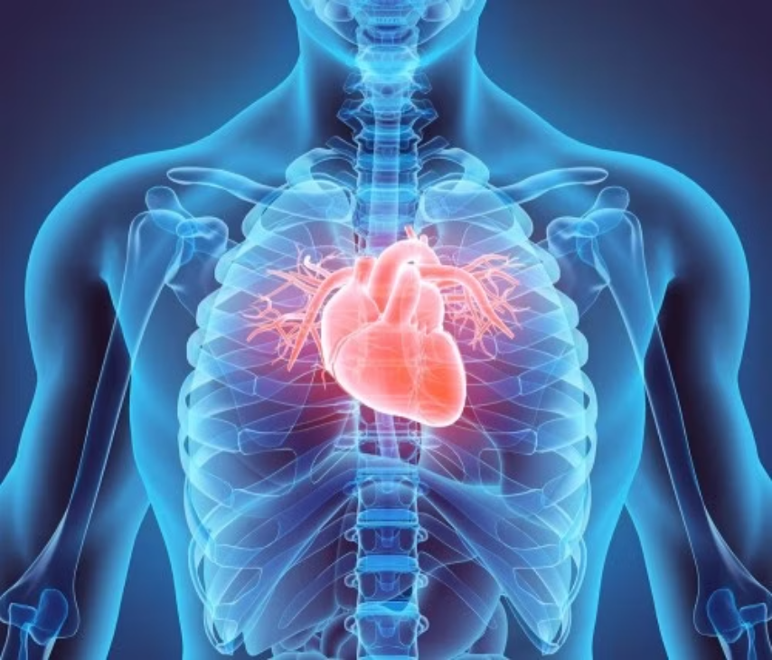
SOLUTION
To address the challenge of early heart disease detection, a machine learning-based web application was developed.
The model utilizes patient medical data to predict the likelihood of heart disease with Logistic Regression, achieving impressive accuracy of around 90%.
A Streamlit dashboard was created to offer an interactive user experience, allowing healthcare professionals and individuals to input health parameters, visualize key insights, and receive instant predictions.
This innovative solution aims to assist in making faster, more data-driven decisions regarding heart health, ultimately improving patient outcomes.

Slide 5
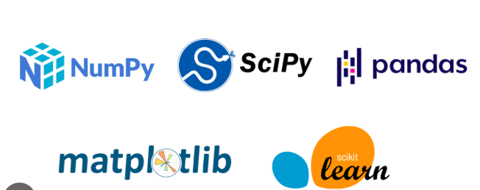



TECHNOLOGIES USED
Programming Language
Libraries & Frameworks
Web Framework
Python: The foundation of our project, chosen for its extensive libraries and ease of use in machine learning.
Scikit-learn, Pandas, NumPy, Matplotlib, Seaborn: Essential tools for data manipulation, statistical analysis, and powerful visualization.
Streamlit: Used for developing the interactive and user-friendly web application, allowing for rapid deployment.
Model Used
Tools & Platforms
Logistic Regression: Our primary machine learning algorithm for binary classification due to its interpretability and effectiveness.
Jupyter Notebook, PyCharm, Streamlit Community Cloud, GitHub: Our development environment, IDE, deployment platform, and version control system.

Slide 6
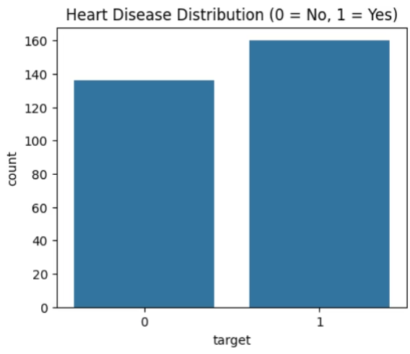
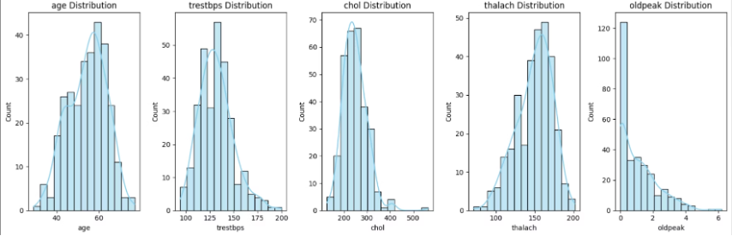
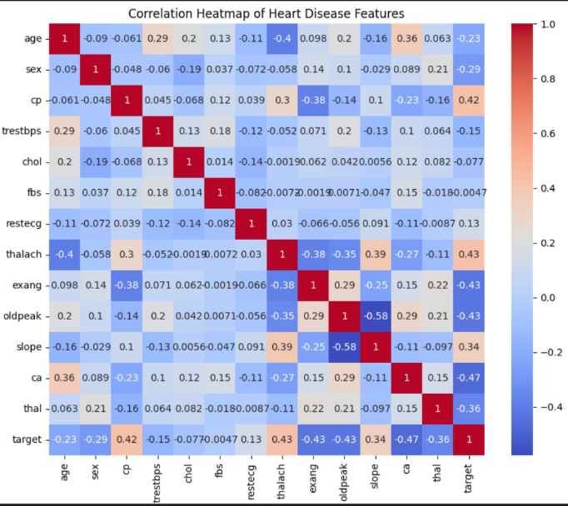
Data Pre-processing & Visualization
Our project utilized the Heart Disease UCI Dataset, comprising 14 distinct features and 303 patient records, specifically chosen for its relevance in predicting heart disease likelihood.
Before model training, the dataset underwent thorough cleaning, including handling missing values and converting categorical variables into a numerical format suitable for machine learning algorithms.
Extensive data visualization was performed using Matplotlib and Seaborn to uncover intricate patterns and relationships between various features.
Crucial insights, such as the correlation between cholesterol levels, age, and the presence of heart disease, were identified. These findings were instrumental in effective feature selection and a deeper understanding of underlying data trends.

Slide 7
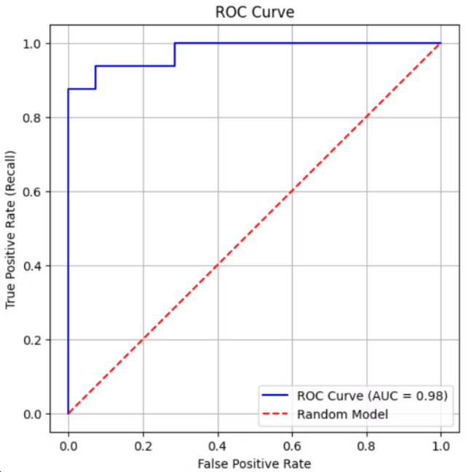
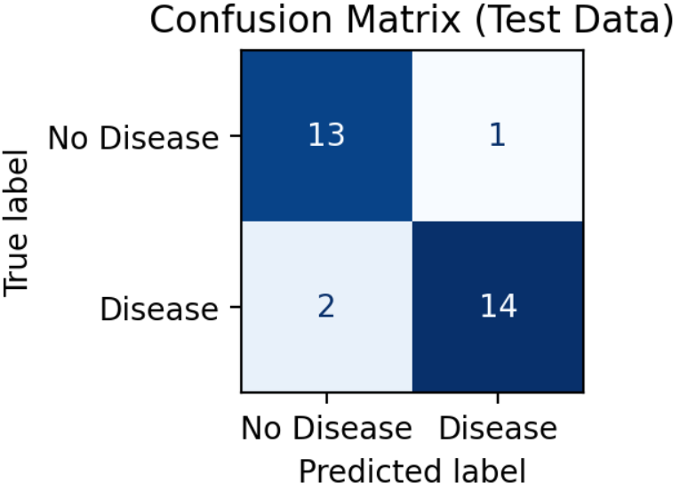
Model Building & Evaluation
The dataset was meticulously divided into training, testing, and cross-validation sets to ensure both accuracy and reliability of the model's performance.
Metric Value
Accuracy
0.90
A Logistic Regression model was rigorously trained using the training data, with the testing set employed to evaluate its performance on unseen data.
Precision
0.93
Cross-validation was applied to further validate the model's consistency and to actively prevent overfitting, ensuring robust generalization.
Recall
0.87
F1 Score
0.90
The model's effectiveness was assessed using key metrics such as Accuracy, Precision,
Recall, and F1-Score.
Visualization tools like the Confusion Matrix and ROC Curve were used to interpret results effectively, providing clear insights into model behavior.
The model achieved an outstanding AUC score of 0.98, indicating its excellent ability to distinguish between patients with and without heart disease.

Slide 8
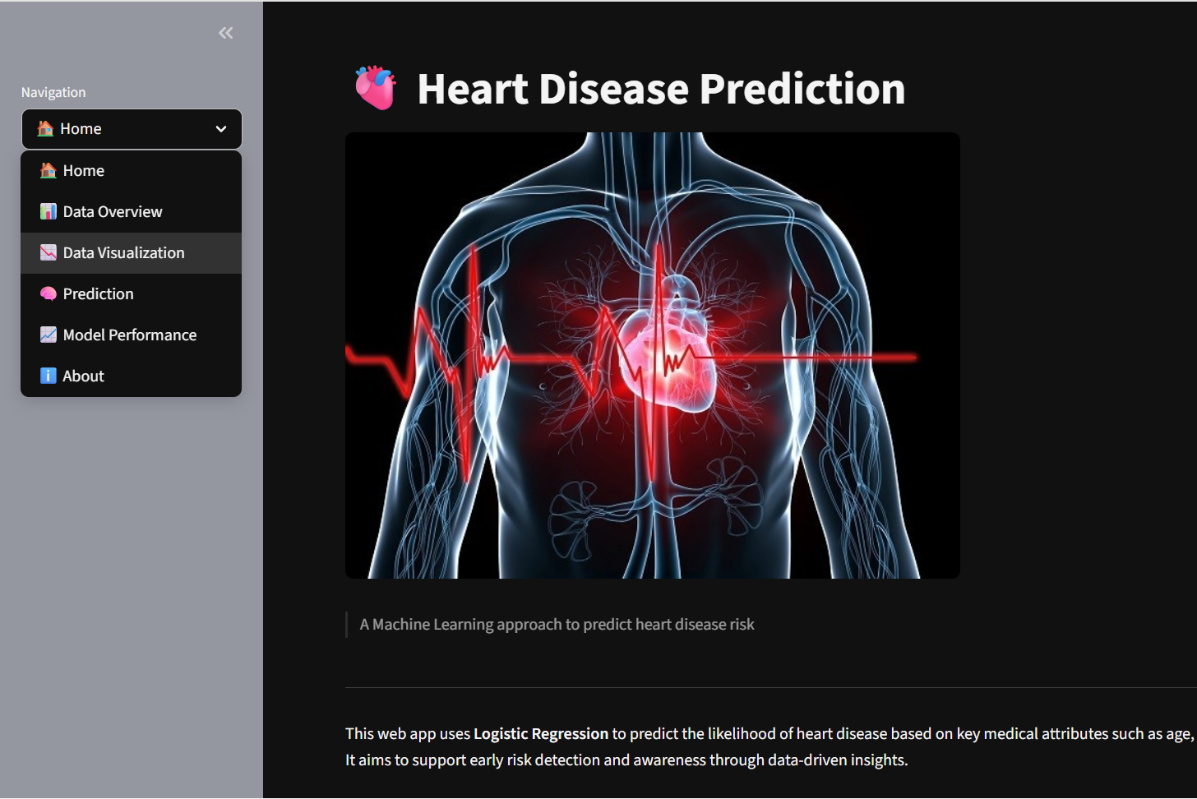
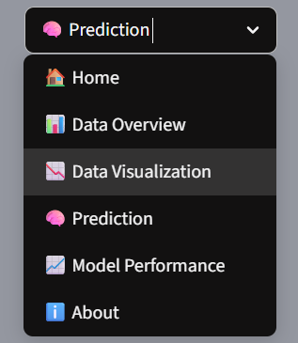
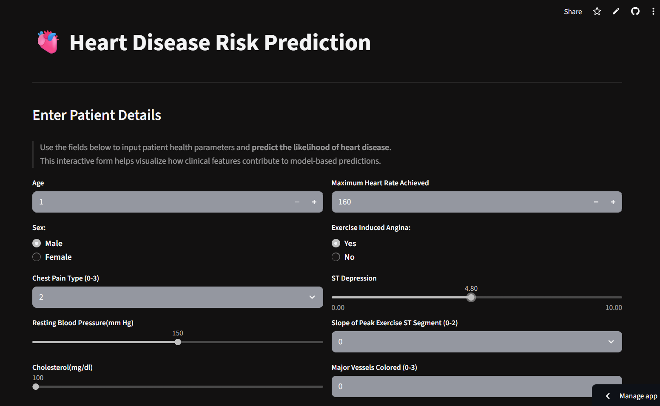
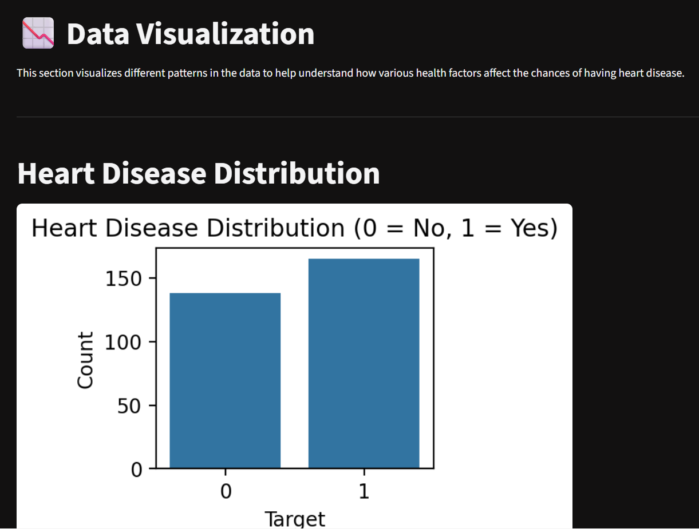
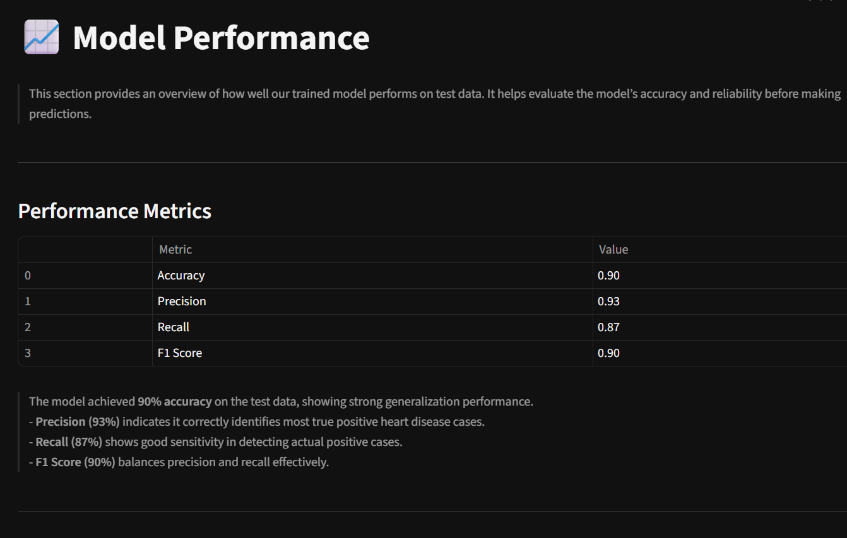
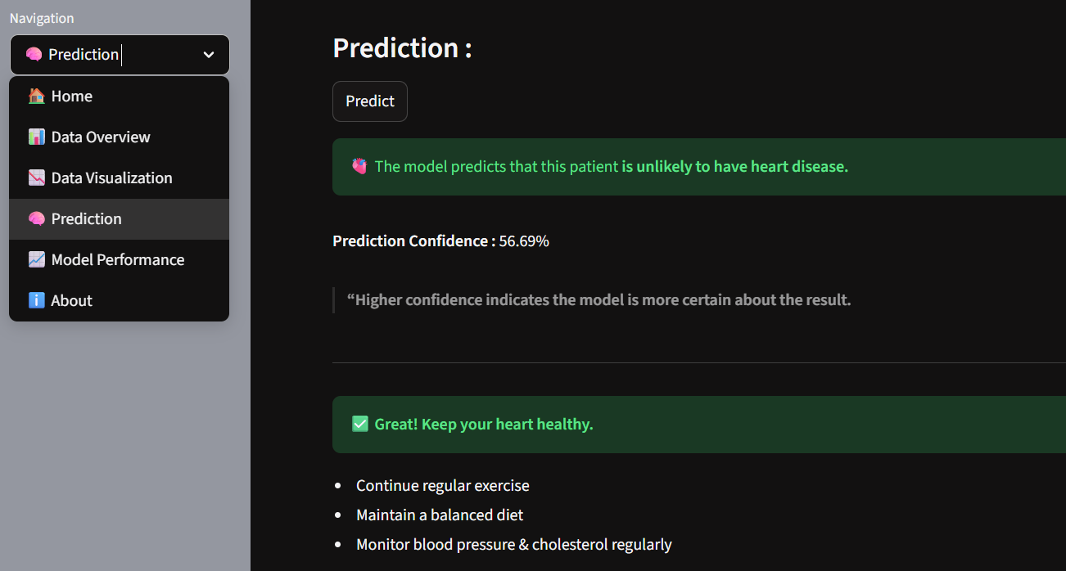
Working of Web App
Demo Video Link: https://drive.google.com/drive/folders/1EHpA4BfrjNZA9YOwOYMGPpOJvOMC2kN6?usp=drive_link
Screenshots:

Slide 9
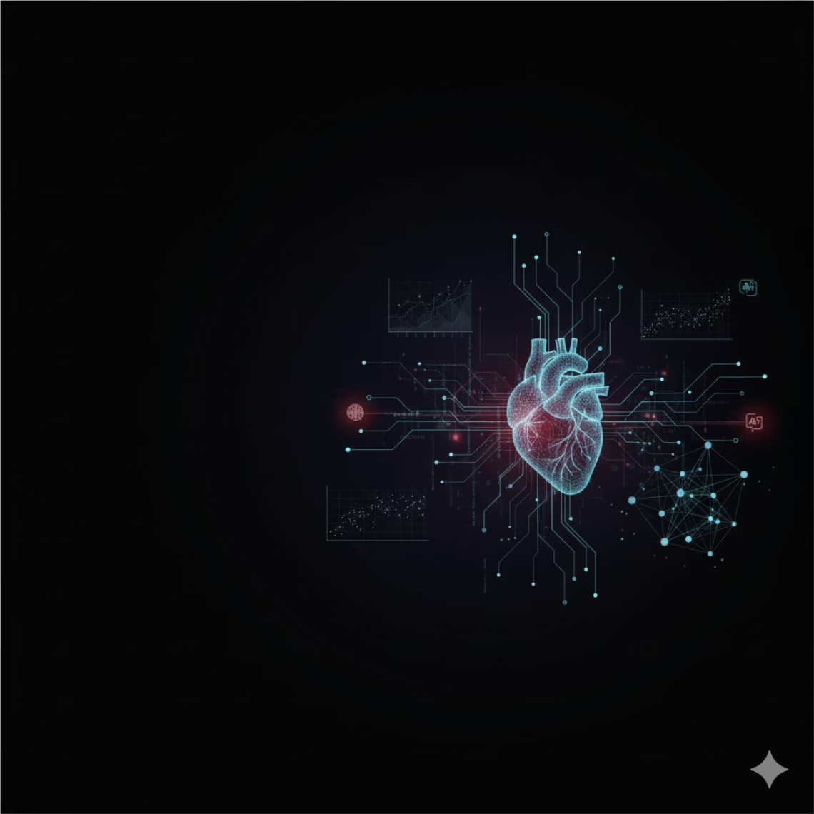
APPLICATIONS
Assists doctors in early diagnosis and decision-making.
Helps identify patients at high risk of heart disease.
Supports preventive healthcare and lifestyle management.
Can be integrated with telemedicine platforms for remote monitoring.
Useful for research and healthcare analytics.
Supports insurance and policy risk assessment.

Slide 10
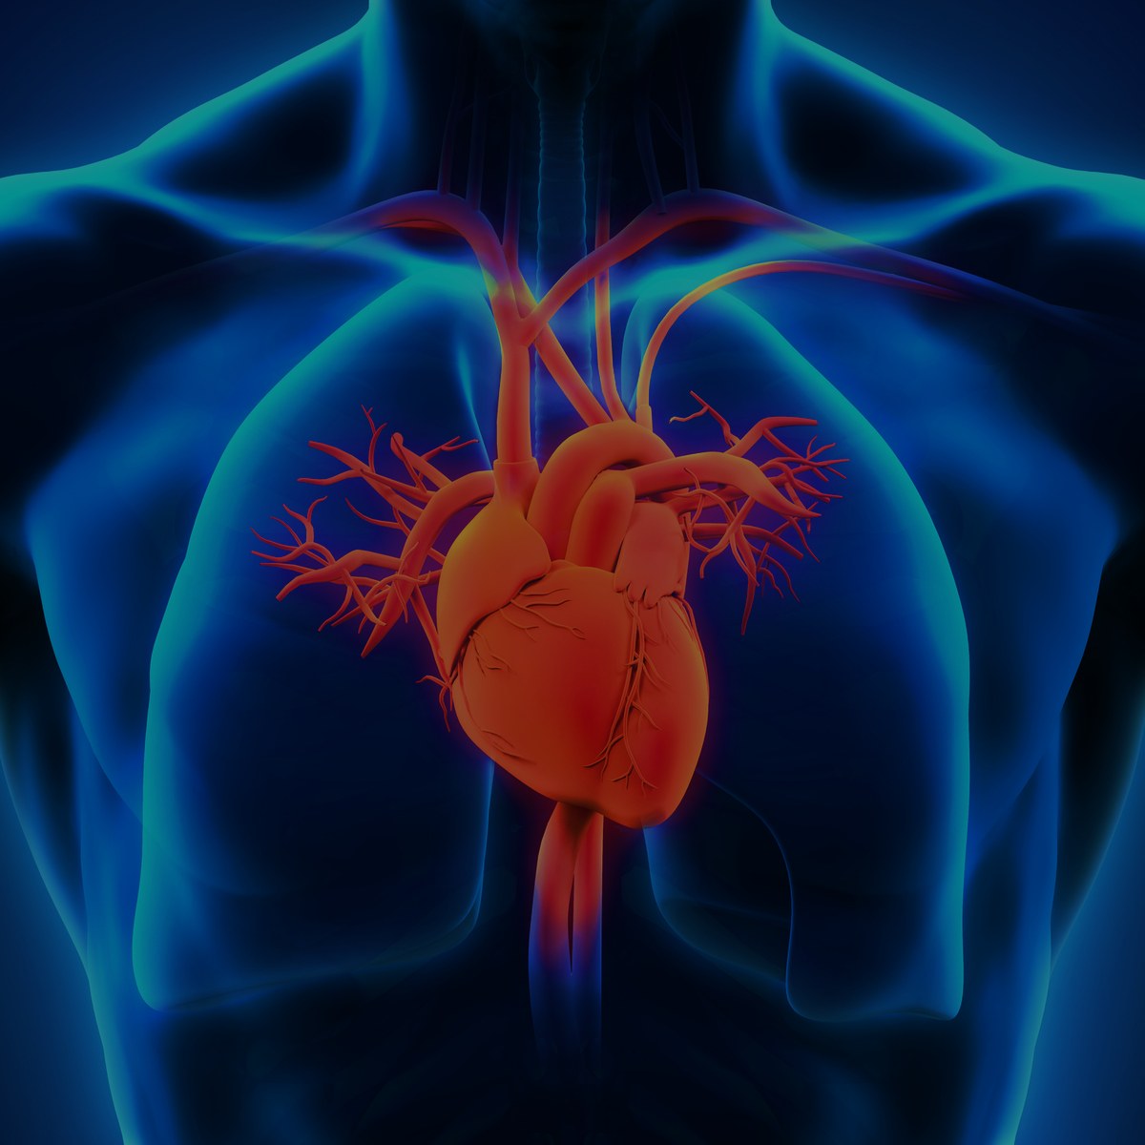
Problems Faced
Faced missing and inconsistent data during preprocessing, which required careful handling.
Difficulty in balancing the dataset, as there were slightly unequal target class distributions.
Minor issues while deploying the Streamlit web app, such as library version mismatches.
Ensuring smooth user input handling and clear visualization layout in Streamlit.

Slide 11


Future Scopes
1
2
3
Real-time Data Integration
Advanced Model Development
Mobile Application Deployment
Integrate real-time patient data from wearable devices and hospital databases for live predictions and continuous monitoring.
Improve prediction accuracy using deep learning models and ensemble techniques, pushing the boundaries of predictive power.
Deploy the system as a mobile application for easier accessibility to users and healthcare providers, fostering broader adoption.
4
5
Diverse Dataset Expansion
Continuous Feedback Loop
Expand the dataset with more diverse patient data to make the model more generalizable and robust across different populations.
Incorporate doctor feedback to continuously refine and validate predictions, ensuring clinical relevance and accuracy.

Slide 12
5
THANK YOU

